Slide 1

A healthy meal delivered to your door, every single day

Slide 2


Slide 3


Slide 4




Slide 5



Slide 6



Slide 7



Slide 8


Slide 9
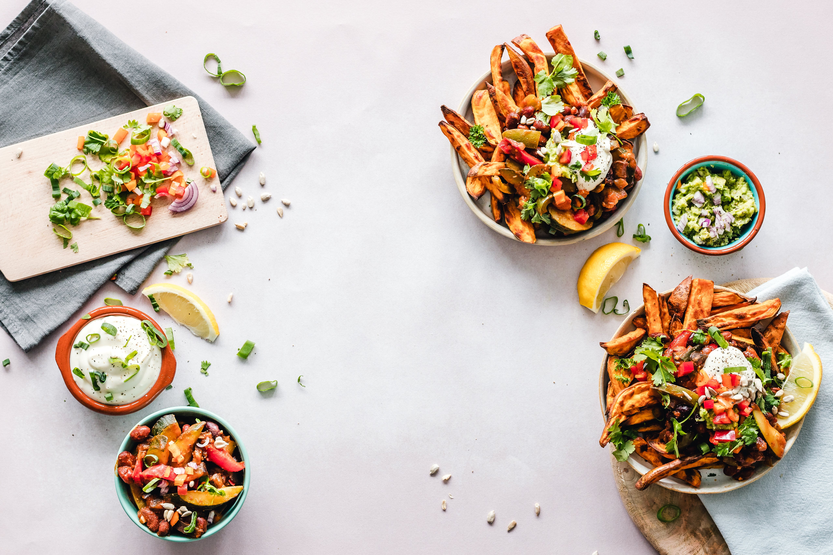

Slide 10


